Slide 1
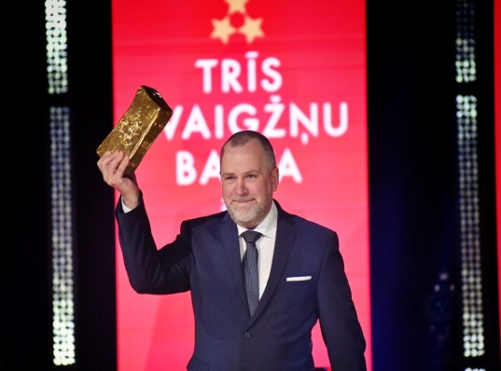
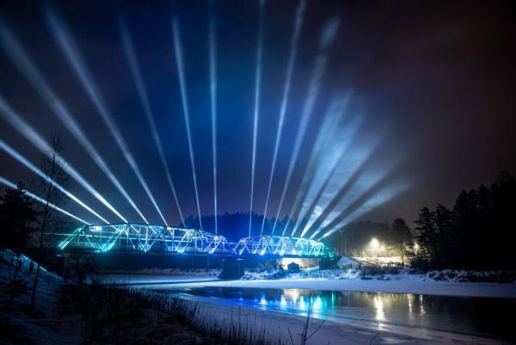
VALMIERA, LATVIA AND SUSTAINABILITY
Presentation Nordplus Adult Project
No. NPAD – 2021/10199
Prepared by NGO Talent City, LATVIA

Slide 2
Valmiera and sustainable development
Sustainability
The municipality of Valmiera County plans and implements sustainable development in the county/town. The aim is to reduce the direct and indirect negative impacts of our actions and to promote positive change in areas where we have competence and influence.
It is important that the inhabitants of Valmiera municipality live, work, study and recreate in a municipality that responsibly implements concrete sustainable development actions that have a positive impact on the quality of life locally, nationally and globally today and in the future.

Slide 3
Valmiera district planning documents
Citizens' participation in the development of Valmiera's development documents is very important, as the sustainable development strategy sets out the long-term development vision (vision), strategic goals, development priorities and specialisation, as well as the spatial development perspective in written and graphic form. The development programme, in turn, sets out the medium-term priorities and a set of measures to implement the development strategy.

Slide 4
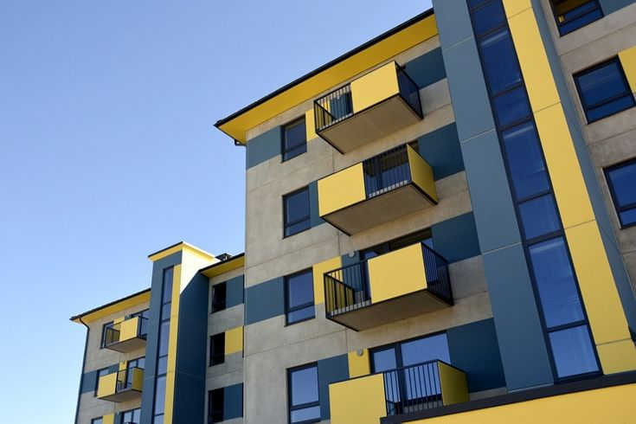
Valmiera - one of the Latvian leaders in renovation of apartment buildings
As of early 2021 - Since 2009 - 84 apartment buildings fully renovated (ERDF) - By 2009 - 10 buildings fully renovated (other funding) - → 94 out of 167 buildings = 56% of Valmiera's buildings fully renovated + some measures taken

Slide 5
Kokmuiža Castle (MANOR) renovated in competition for sustainable construction, architecture and design
In the nomination "Most Sustainable Building 2021 in Latvia", the renovated Kokmuižas Castle (Manor), where the Kocēni Primary School operates on a daily basis, received recognition.

Slide 6
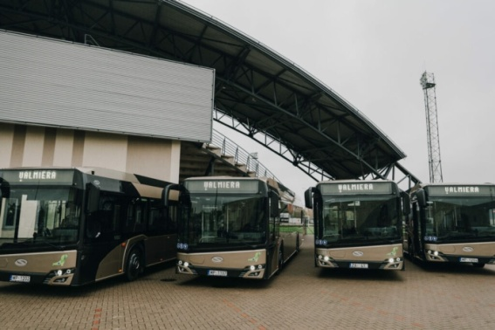
Sustainable public transport
Hybrid buses open in Valmiera
Significant changes in Valmiera's public transport system - 9 new diesel-electric hybrid buses unveiled.
"Hybrid buses on Valmiera city routes are a big step towards improving the quality of life and a sustainable investment in the city's development. Being environmentally friendly is a value and an important task for all of us. The Gauja river golden sand-coloured buses do not have a limited range and do not need an electric charging infrastructure. The decision to choose hybrid buses was taken after assessing the route network of Valmiera city, the length of the journeys, taking into account the climatic conditions, as well as the possibilities to ensure the continuous sustainability of public transport services in Valmiera.
The total purchase price of the buses is EUR 2999700.

Slide 7
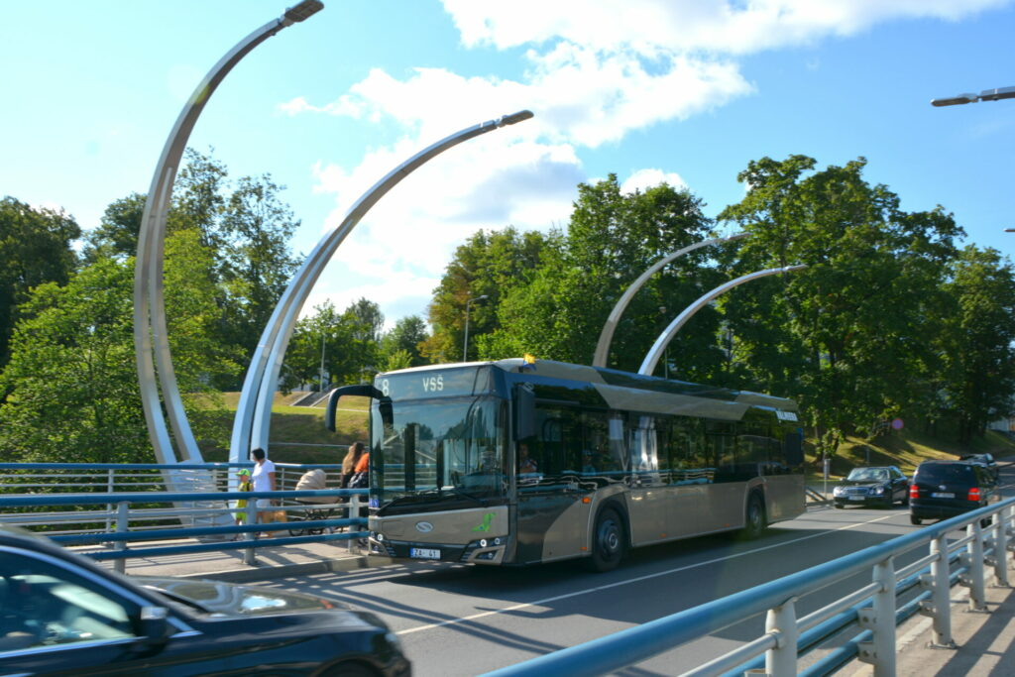
The tenth hybrid bus in Valmiera started running at the end of the year
Reduction of environmental impacts:
CO2 reduction - 133 t
NOX reduction - 10.4 t
Noise reduction - 2 %

Slide 8
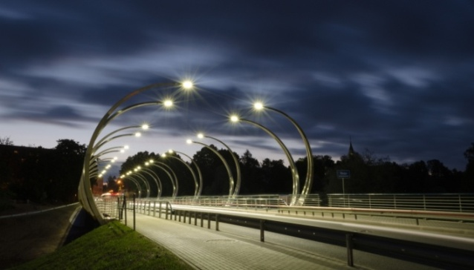
Energy management system
ISO-certified energy management system in Valmiera
Implementation of smart technologies in the lighting system of Valmiera
1. replacement of 452 existing street luminaires with LED street luminaires with smart sensors and smart lighting control system, which will ensure the regulation of lighting level according to the current pedestrian and vehicle flow;
2. electricity savings 337293 kWh/year;
3. carbon dioxide emission reduction 36764, 93kg CO2/year;4. carbon dioxide emission reduction efficiency indicator 0,1023 kg CO2/year/yr.
The total length of Valmiera's lighting network with 3649 light points is 122.27 km. 81.82 km of them are currently controlled by the Lucidus Smart automatic street lighting control system. The system ensures that the city's street lights are managed remotely. The lights are automatically adjusted to switch on and off according to sunrise and sunset times - they come on 15 minutes after sunset and switch off 15 minutes before sunrise. This saves energy without wasting it during daylight hours.

Slide 9
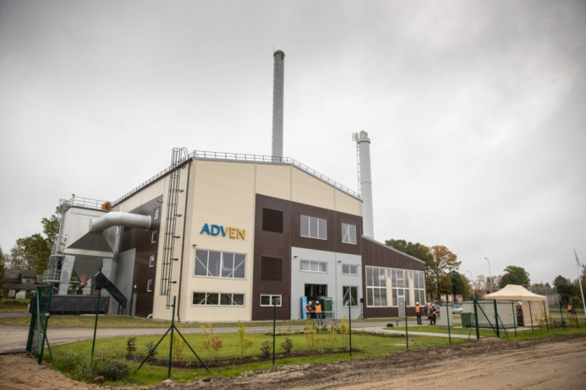
Heat production
84% of district heating in Valmiera and municipal associations is produced from 90% "brown" wood chips, while in Kocēni, Rūjiena associations even 100% is produced from wood residues, ensuring social protection against natural gas price fluctuations.
A woodchip boiler house with modern technological solutions opened in Valmiera
With an investment of EUR 5.148 million, including EUR 1.66 million co-financed by the Cohesion Fund of the European Union, the new woodchip boiler house of "Valmieras Enerģija" was inaugurated in Valmiera. The woodchip boiler house will not only contribute to Valmiera's energy independence from fossil fuels as a city, as more than 90% of the company's output will come from renewable energy sources, but will also reduce greenhouse gas emissions by 10 000 tonnes of CO2 equivalent per year. It is strategically important for Valmiera City Municipality to ensure the long-term well-being of its citizens and care for the environment, and the construction of the energy-efficient woodchip boiler house is an important step towards achieving this goal.

Slide 10
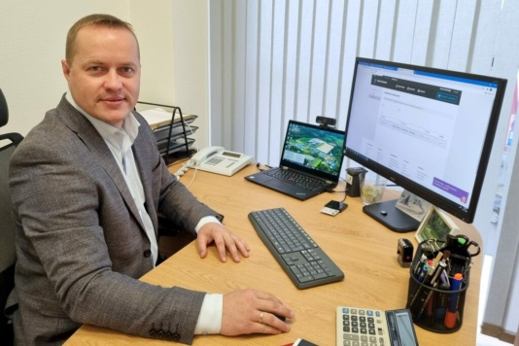
Biodegradable waste management
ZAAO launches biodegradable waste recycling plant
On 3 November, ZAAO, MRK Serviss Ltd and AIMASA Ltd signed a contract for the design and construction of the project "Establishment of a biodegradable waste recycling plant in Daibe".
The project is scheduled to be completed by 1 November 2023.
The establishment of the Biodegradable Waste Treatment Plant (BWTP) aims at reducing the amount of biodegradable waste to be disposed of, thereby increasing the efficiency of waste utilisation.
The plant will process biodegradable waste from municipal waste, separately collected garden and park waste and separately collected food waste.
A two-stage bio-digestion process combining anaerobic digestion and aerobic digestion (composting) technology is envisaged for the treatment of BNA. The planned capacity of the BNA processing plant complex is 20 854 t/year.
The recycling process will produce compost. Biogas will be produced as a by-product to be used for the production of heat and electricity.

Slide 11
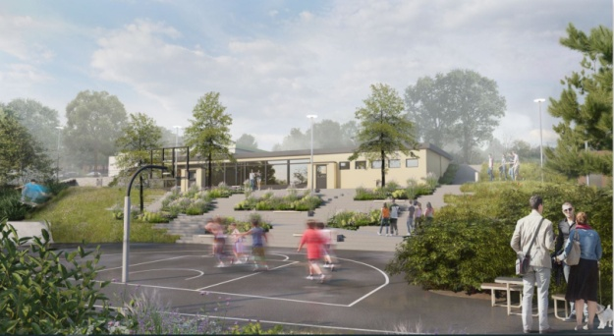
Adapting to climate change Developing health and nature-friendly urban environments
Construction of the sports and active recreation park "Mežs" (FOREST) has started
The sports and active recreation park "Mežs" (FOREST) will be built on an area of 11152 m2 on the site of a former skate park and an adjacent fenced children's playground. The park will have separate areas for a skate park and a cycle track. The 1096 m2 hard-surfaced multi-level skatepark, suitable for multi-purpose use, will be suitable for riders of different levels

Slide 12
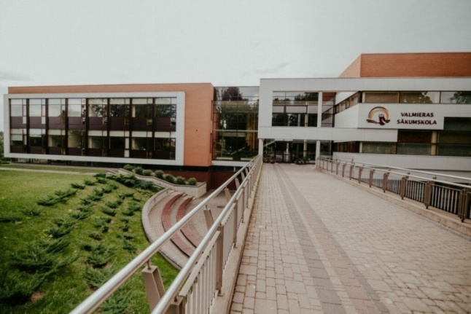
Knowledge society
Full-cycle education from pre-school to university, non-formal and special interest education is part of the international Eco-Schools education programme.
VALMIERA PRIMARY SCHOOL
For the history of the school until 2010, see www.vss.edu.lv/skola/vēsture.
The school building was commissioned in September 2010.
In 2010, the school was recognised as the "Best Building of the Year in Latvia", as well as the "Most Energy Efficient Building in Latvia". In 2011, the school was awarded the Promethean Education Centre of Excellence. Since 2012, the school has been a member of the UNESCO Associated Schools Project. In 2016, the school was awarded the Latvian Eco-Schools title and certificate. In 2016 the school was awarded the title of Health Promoting Educational
Institution Homepage: vss.edu.lv

Slide 13
Openness and participation in sustainability initiatives
Six "ZILE 2021" innovation projects implemented in Valmiera Region
Innovations in veterinary medicine
Robotics in furniture production
More efficient production of sparkling natural fruit lemonade
Tennis court automation and management system
Speech recognition technology for medical documents
3D printing technology for architectural projects

Slide 14
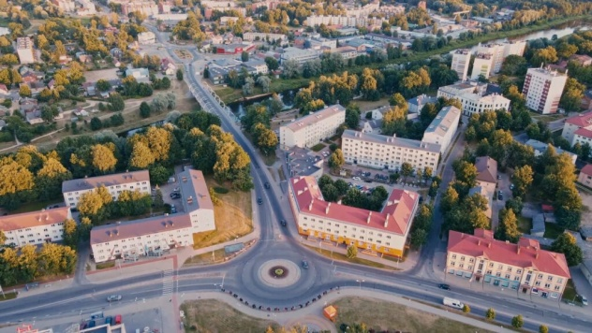
Valmiera and the 13 Global Development Goals Index Project "Sustainable urban development model in line with UN targets" ( lzp-2020/2-0073).
The model is based on the UN's 17 Sustainable Development Goals (SDGs), 13 of which are relevant to local government. 49 indicators are taken into account to determine the city's sustainable development index, which shows the level of sustainable development of the territory.
The model is applicable to any territory - urban and rural, county and region - in Latvia and the EU.

Slide 15
Valmiera's slogan/motto - Living green! (Evergreen city!)
We live green because we strive for growth and development
We live green because we are proud of and celebrate our achievements
We live green because we are responsible for and proud of the environment

