Slide 1

Gender and education in Finland
#gender equality #equal treatment #family models #gender roles #4R #normcriticism

Slide 2
Gender equality in Finland

Slide 3


Women in Finland enjoy high-quality education.
In fact, Finland ranked first in the world in leveling the gender gap in educational attainment in 2018. The consistently high levels of education among women show this. Among those obtaining a university-level or post-graduate in 2012, the proportion of women was 60% and 50%, respectively. Moreover, the rate of female educational attainment is increasing rapidly and significantly outpacing that of men, as the share of women earning post-graduate degrees jumped from 15% in 1975 to 54% in 2012.
Finland offers one of the most generous parental leave policies in all of Europe.
A February 2020 policy granted seven months of paid leave for new mothers as well as one month of pregnancy allowance prior to their official leave. Non-biological parents have access to the same parental leave privileges while single parents receive a full 14 months of paid leave. This updated policy also extends the seven months of parental leave to fathers and allows parents to transfer up to 69 days from their seven-month allotment to the other parent. Gender-neutral parental leave policies are a crucial step toward gender equality by leveling the gap between conventionally male and female roles in society and relieving women of the tradition of them solely raising their children.
Finland is a victim of the “Nordic Paradox,” the trend where Scandinavian nations experience high rates of domestic violence despite promoting gender equality in economic and political life.
The 2013 rate of intimate partner violence in Finland was nearly double the European average. Domestic violence rose 7% in 2019 with over 10,000 reported victims, more than half of which were between married couples. Finland has taken steps at the national level to address this trend, having adopted a National Gender Action Plan and trained about 200 federal judges in prosecuting cases involving violence against women. Moreover, crisis shelters and a free 24/7 helpline are available, with specialized investigators and law enforcement officials to address reports of violence. The Finnish Institute for Health and Welfare oversees these shelters, which also provide professional counseling and health services to customers.

Slide 4

Women dominate the labor market.
Finland enjoys the highest labor participation rate of women worldwide and ranks among the best nations for working women. Moreover, the employment rate for Finnish women is higher than the European Union average. However, Finland needs to still make improvements, as women in the public and private sectors receive only 80% to 85% of their male counterparts’ earnings. Nonetheless, the gender pay gap has been steadily decreasing over the last two decades and expectations have determined that it should continue to decrease as a result of social welfare policies that allow women to reconcile family and work life.
Political institutions provide equal representation.
Finland’s government has a history of pioneering gender equality, being the first parliament in the world to include female members of parliament. Finland elected its first female prime minister in 2003, and its third female prime minister, Sanna Marin, assumed office in December 2019. Marin leads a coalition government consisting of five parties, all of which have women under the age of 35 at the helm. Female representation in the nation’s 2019 election was especially notable, with a record number of women winning parliamentary seats, amounting to 47% of the parliament. As a result, Finland ranked sixth globally in political empowerment for women in 2018.
Migrant women are a major part of Finland’s equal rights agenda.
Immigrant women with children experience an employment rate that is nearly 50% lower than that of their native-born counterparts, and social integration has posed a challenge for these communities. To address this issue, the Social Impact Bond emerged through institutional and private investment to assist immigrant women in finding employment within four months. Moreover, the national government finances public language programs to offer support to recent migrants learning the Finnish language.

Slide 5
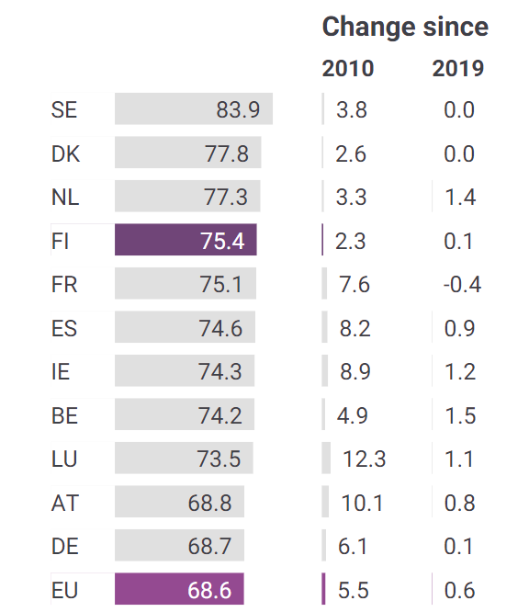
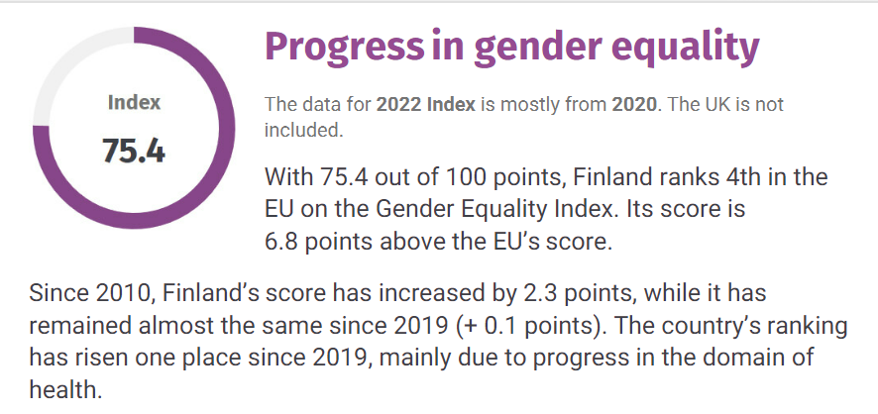
Gender equality index

Slide 6
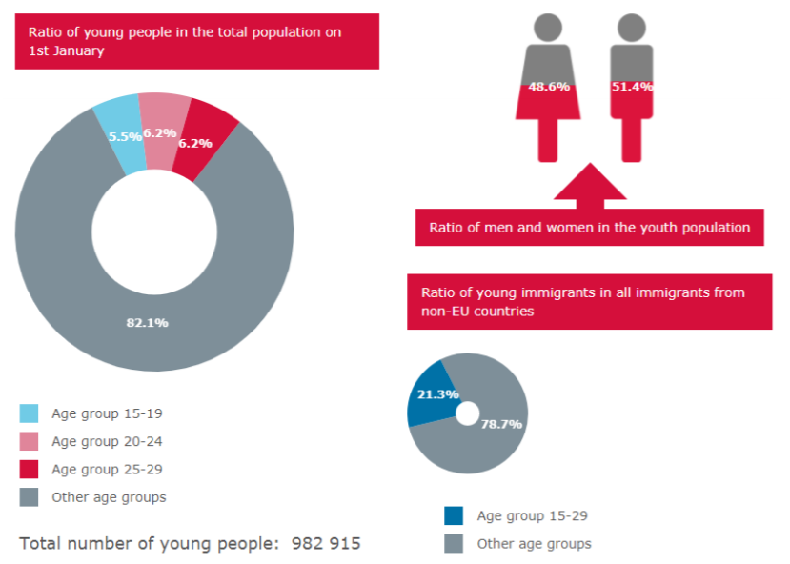
Empowerment of women
The aim of Finnish development policy and cooperation is to eradicate poverty and empower ordinary people – women and men, girls and boys – to strive towards economically, socially and ecologically sustainable societies.
Nationally, Finland has a long history of promoting women empowerment equality.
Finland is often depicted as an equality trailblazer and paradigm of sustainable development.

Slide 7

In the 2019 parliamentary election, the proportion of women elected reached a record high. Women now account for 46 percent and men for 54 percent of all members of parliament.
The proportion of women in parliamentary groups varies by party. The Green Party has the highest number of women (85%) and, with the exception of single-member parliamentary groups, the Finns Party has the lowest number (28%).
Finnish politics today is dominated by women, many under the age of 35. This is a result of long-standing efforts to include more women in leadership.

Slide 8


Write down the greatest achievements in your life that you are really proud of.
ⓘ Start presenting to display the poll results on this slide.

Slide 9
Education in Finland

Slide 10
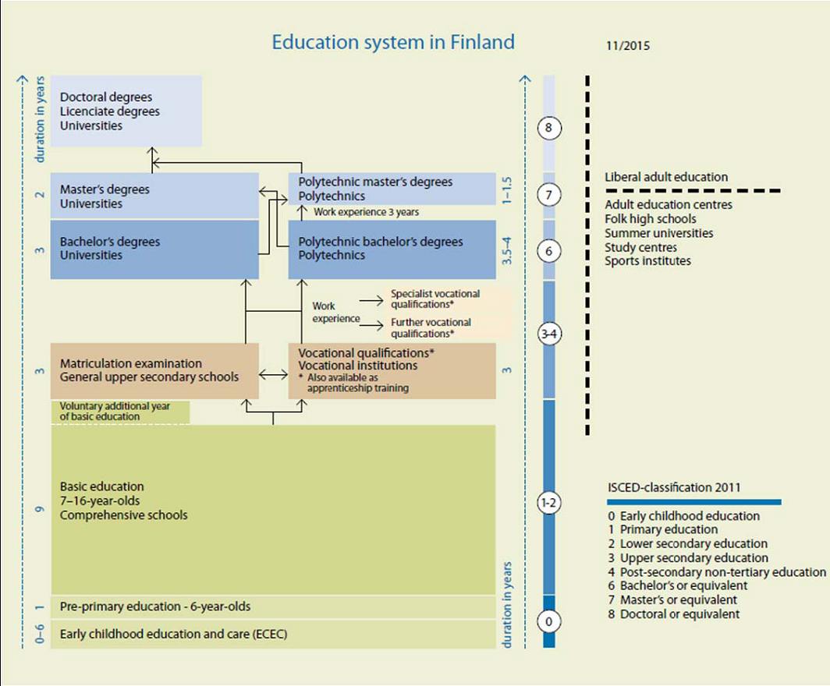
The Finnish education system is composed of:
A) a nineyear basic education (comprehensive school) for the whole age group (age from 7 to 16 years old), preceded by one year of voluntary pre‐primary education for six year old children.
B) Upper secondary education, comprising general education and vocational education and training (vocational qualifications and further and specialist qualifications) and
C) higher education. Higher education is offered by universities and polytechnics (also known as universities of applied sciences). Universities emphasize scientific research and instruction and universities of applied sciences adopt a more practical approach.
Professionals working in the field of logistics and blue economy have in most cases completed an upper secondary education degree or higher education degree.

Slide 11
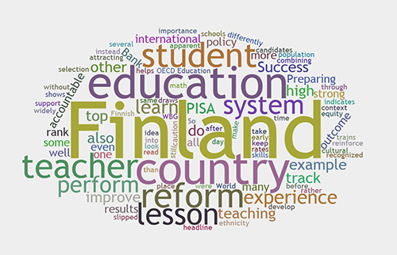
Finns are not sorted into classes of students, educational institutions according to their abilities and career preferences.
Also, there are no "bad" and "good" students. Comparison pupils with each other is prohibited. Children are ingenious and with a large deficit mental abilities are considered "special" and learn with them. In general, the team trained and children on wheelchairs. Finns are trying as much as possible to integrate into the society of those who require special treatment. The difference between the weak and strong students - the smallest in the world
Reforms in Curriculum from a Government level
The Finnish government has made several reforms in terms of the Curriculum. However, the most notable one came in 2013-2014, which replaced the Education act of 2010. Here are a few questions considered when developing the curriculum.
What will education mean in the upcoming days?
What skills will be needed in everyday life?
How does the curriculum support teachers and not just the students?
How does this change help schools locally? And so on.
All students in Finland receive a free education from when they start at seven years of age until they complete their university studies. During their educational journey all pupils receive free school meals, resources and materials, transport and support services.

Slide 12
Write down the qualities / characteristics that have helped you achieve these things?
ⓘ Start presenting to display the poll results on this slide.

Slide 13
Promoting gender equality in Finish schools

Slide 14
Teachers have the opportunity to shape the way children view gender. Setting a healthy standard for how male students should treat female students can help end violence against women. According to a YouGov survey, only 13% of young women’s knowledge about domestic violence comes from school. This makes sense when you find out that 9 out of 10 young women in the YouGov survey said they had not learned about domestic violence in school.
Ways to Promote Gender Equality in The Classroom
1. Avoid separating male and female students
Not only does separating students within the classroom inhibit male and female students learning to socialise with each other, but it does not allow for non-binary student to feel comfortable and seen. So, avoid things like ‘girls vs boys’ games, for example.
5. Include literature that is inclusive and free of gender stereotypes
Children are inspired by stories that they can relate to, with characters that look like them. Therefore, reading books about women becoming scientists, and boys becoming nurses, helps promote equal job opportunities and goals as they grow up.
2. Promote all genders working together
Perhaps the best way to promote gender equality in the classroom is by simply encouraging everyone to work together. Teamwork is a valuable life skill regardless, but letting students of all genders work together free from stereotypes will teach them that gender really don’t matter at all.
6. Swap out gendered words
It’s a good idea to start replacing phrases like “mum and dad” for “parent/s” or “caregiver/s”. This helps create an inclusive environment in which kids with same-sex parents feel included, and where every family dynamic is represented.
It’s also important for non-binary gender inclusion, that in sex education especially, we de-gender anatomy. For example, instead of saying “lady parts” and “boy bits” try to use anatomically correct terms that do not exclude transgender students.

Slide 15
What gender do you identify as?
ⓘ Start presenting to display the poll results on this slide.

Slide 16

Do you identify with the gender status assigned to you at birth?
ⓘ Start presenting to display the poll results on this slide.

Slide 17
Norm criticism

Slide 18
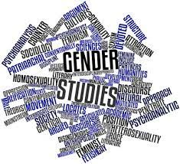
What is Norm Criticism?
Norm criticism is both a way of analysing and understanding norms and power structures as well as a tool for challenging and dismantling norms. By using norm criticism one can raise awareness of the privileges, power imbalances and exclusion that some norms create. It is also a way to challenge power structures and combating marginalisation of groups in society.
However, once a link between power relations and norms is discovered, it can be changed, too. It is a good idea thereby to combine norm criticism with other tools and methods (of which you can read in other parts of the series: for example the GET, the Staircase Models, or the 4R). Norm criticism is part of a gender impact assessment procedure, in which the system and its conditions are shaped to be more inclusive and balanced in terms of gender.
If you are in a privileged position and fit a certain norm, you are also in the position to either take it for granted and not do anything… or to change it, in favour of those who are less privileged and therefore have less chance to shape the situation.

Slide 19

Normal or not
Trust or not
ⓘ Start presenting to display the poll results on this slide.

Slide 20

4R method
● 1R: Which representation women, men or trans people have in an activity
● 2R: How women, men and trans can take part in an activity (as in school activities municipal activities and service (resource distribution among gender) Description of the differences in terms and conditions for women, men and trans based on the data from R1 and R2. (Qualitative)
● 3R: Which norms prevail within these activities (gender patterns and their consequences) Together, the quantitative and qualitative findings guide towards the direct and concrete changes that should be implemented to improve equality.
● 4R: How can a change be promoted
(a gender equality plan)

Slide 21

Laura Maria Rajala
+358404145844
mrajalalaki@gmail.com

