Slide 1



SDG 4 benchmarks
Fulfilling a neglected commitment,
supporting the global education cooperation mechanism
Silvia Montoya Director, UNESCO Institute for Statistics
Manos Antoninis Director, Global Education Monitoring Report Global Education Summit 28 July 2021
NEERAZ CHATURVEDI/Shutterstock.com

Slide 2




Benchmarks are a neglected
Education 2030
Framework for Action commitment
UN Secretary General Synthesis Report, 2014
Called on countries to “embrace a culture of shared responsibility, one based on … benchmarking for progress” (§146)
Education 2030 Framework for Action, 2015
Called on countries to establish “appropriate intermediate benchmarks (e.g., for 2020 and 2025)” for the SDG indicators, seeing them as “indispensable for addressing the accountability deficit associated with longer-term targets” (§28)
Global Education Meeting, 2020
“We request UNESCO and its partners, together with the SDG-Education 2030 Steering Committee, to … accelerate the progress and propose relevant and realistic benchmarks of key SDG indicators for subsequent monitoring” (§10)

Slide 3
Process towards benchmarks in 2021
2021
2019
2020
JUL
NOV
2022
Agreement on seven indicators
TCG6
Global Education
Meeting
UNESCO General Conference
Adoption of technical process
TCG7
Regional benchmarks endorsed as first step to national benchmarks
National benchmarks endorsed
GOAL
KEY ACTIONS
Regional organizations propose minimum regional benchmarks
Member States
propose
national benchmarks

Slide 4







Benchmarks for seven SDG 4 indicators
GLOBAL
REGIONAL
NATIONAL
Priority policy areas
SDG 4 benchmark indicators
4.1.1 Minimum proficiency in reading/maths
4.1.2 Completion rate
4.1.4 Out-of-school rate
Definition of regional minimum levels for global indicators
+
Indicators selected from regional frameworks:
Africa
Arab States
Asia/Pacific
Europe/North America
Latin America/Caribbean
Definition of national commitment for
global indicators
+
Indicators selected from national frameworks
Basic
education
Pre-primary
4.2.2 Participation in organized learning
a year before primary education entry
Teachers
4.c.1 Qualified teachers
Expenditure
1.a.2/FFA Education as % GDP / % budget
Equity
4.5.1 [To be defined]

Slide 5



Benchmarks for seven SDG 4 and regional indicators
GLOBAL
REGIONAL
Priority policy areas
SDG 4 benchmark indicators
4.1.1 Minimum proficiency in reading/maths
4.1.2 Completion rate
4.1.4 Out-of-school rate
Definition of regional minimum levels for global indicators
+
Indicators selected from regional frameworks:
Africa
Arab States
Asia/Pacific
Europe/North America
Latin America/Caribbean
Basic
education
Pre-primary
4.2.2 Participation in organized learning
a year before primary education entry
Teachers
4.c.1 Qualified teachers
Expenditure
1.a.2/FFA Education as % GDP / % budget
Equity
4.5.1 [To be defined]
TVET / Higher education
Africa: +2 (NEET; STEM)
Asia/Pacific: +3 (adult education; tertiary GER; STEM)
Europe: +2 (adult education; tertiary GER)
Africa: +1 (Participation TVET grads in LF)
Asia/Pacific: +1 (youth/adult TVET participation)
Europe: +2 (VET graduates work-based learning; digital skills)
Skills for work
Learning
environment
Africa: +2 (schools with electricity/Internet/computers; WASH)

Slide 6
Role of regional benchmarks
What are regional benchmarks?
= minimum targets to be achieved by all countries in a region
◆ In homogeneous regions, they are relevant for many countries
◆ In heterogenous regions, they are relevant only for countries furthest behind but can foster shared responsibility
Why regional benchmarks in addition to national ones?
1. Regional organizations have unique role to facilitate peer dialogue and national benchmark setting
2. Regional organizations may want to benchmark indicators from their own monitoring framework
3. Help align global, regional and national education monitoring frameworks for coherence

Slide 7
Regional organizations’ participation in benchmark process
2020
2021
Progress
October
November
December
January
February
March
April
May
June
Consultations UIS & the African Union Commission
Consultations with AU member states, Regional Economic Communities (RECs) and key stakeholders
UIS and IPED organize 5 regional meetings on benchmarking process
Agreement on all proposed indicators for regional benchmarks
Regional indicators proposed
Final Report Africa – First Phase
Regional technical consultation on SDG4/CESA 16-25 with Member States
AFRICA
ASIA AND PACIFIC
UIS partnered with UNESCO Bangkok and Learning and Education2030 + Networking Group in establishing regional benchmarks for the region
Regional partners: ASEAN, SEAMEO, SAARC, SPC
Agreement on all proposed indicators for regional benchmarks
Regional indicators proposed
Final Report Asia/Pacific – Phase 1
Regional consultation and technical team meetings
Sub-regional consultations; country feedback
ARAB
STATES
UIS partnered with UNESCO Beirut in establishing regional benchmarks for the region
Regional partners: ABEGS, RCEP
Commitment to benchmarking process
Proposed benchmarks shared with Member States
Summary report scheduled
High-level meetings
Consultation with regional stakeholders and one-to-one meetings with Ministries of Education
Alignment of CARICOM Phase 1 indicators to the 7 benchmark indicators
Bridging Latin America and the Caribbean Monitoring Frameworks and SDG 4
LATIN AMERICA
Regional partners: ECLAC, OEI, CARICOM, CECC-SICA
EUROPE
Alignment with 3 out of 7 European Education Area benchmark indicators

Slide 8

Role of national benchmarks
What are national benchmarks?
= contribution of each country to the achievement of SDG 4,
given their starting point
To be proposed for 2025 and 2030 for seven SDG 4 indicators
e.g. climate change-related national determined contributions
When
◆ National SDG 4 focal points to submit by October 1
◆ Submissions to be compiled by October 15
How
◆ Use targets specified in the national strategy/plan
◆ If a country does not yet have targets in the national strategy/plan, use Technical Cooperation Group website resources to help decision
http://tcg.uis.unesco.org/benchmarks/

Slide 9
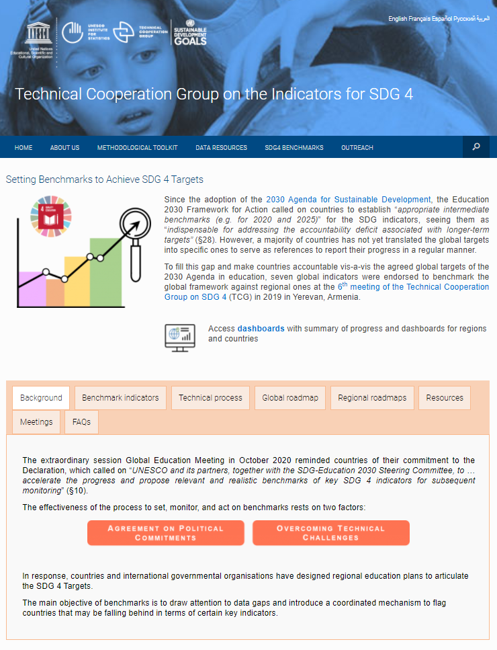
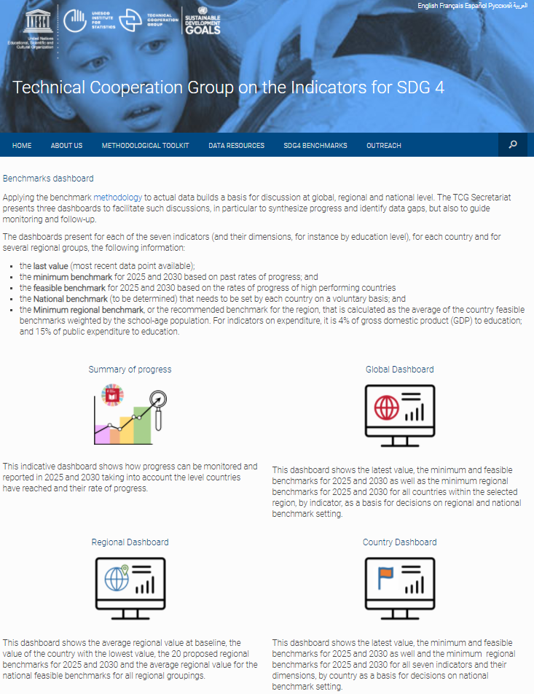

Slide 10
Thank you
Learn more http://tcg.uis.unesco.org/benchmarks/

