Slide 1
Gender equality and environmental issues
Barbi Pilvre, Ph.D
Tallinn University

Slide 2
Everybody's right to live in a healthy environment
Environmental Justice or Environmental Equality by MobilizeGreen: “Every single person has the right to live in a healthy environment, regardless of race, income, age, gender and nationality. No one's health or quality of life should suffer because of the environment they live in.”
If environmental equity is a basic human right, environmental justice is the act of protecting that right.
Environmental justice involves the actions and activism necessary to highlight inequities and level the playing field.

Slide 3
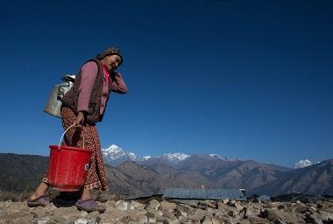

Slide 4
Gender inequalities reduce environmental justice
Gender inequalities, such as weak rights to own land and reduced access to energy, water and sanitation facilities for women, have a negative impact on human health, the environment and sustainable development.
https://www.unicef.org/press-releases/unicef-collecting-water-often-colossal-waste-time-women-and-girls
Gender equality prevents violence against women and girls. It's essential for economic prosperity. Societies that value women and men as equal are safer and healthier.

Slide 5
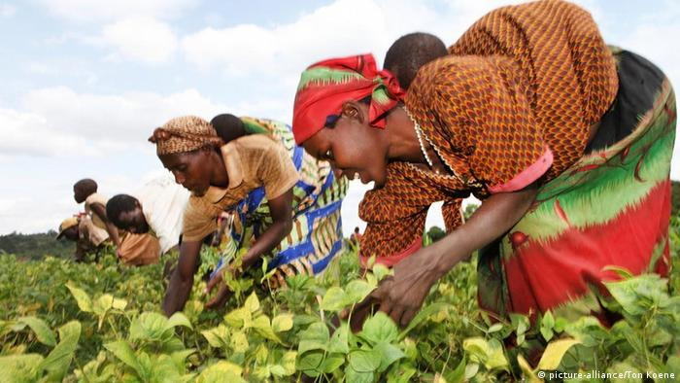

Slide 6
What causes gender inequality
Uneven access to education.
Lack of employment equality.
Job segregation.
Lack of legal protections.
Lack of bodily autonomy.
Poor medical care.
Lack of religious freedom.
Lack of political representation.

Slide 7
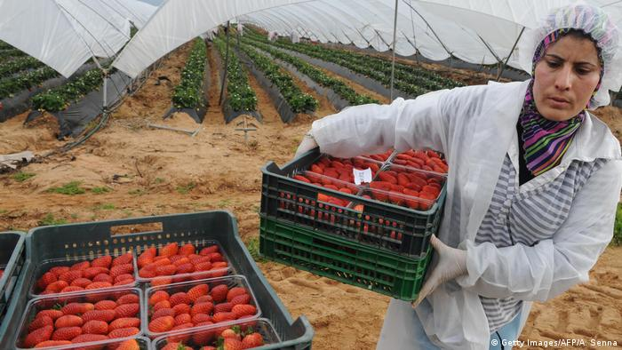

Slide 8
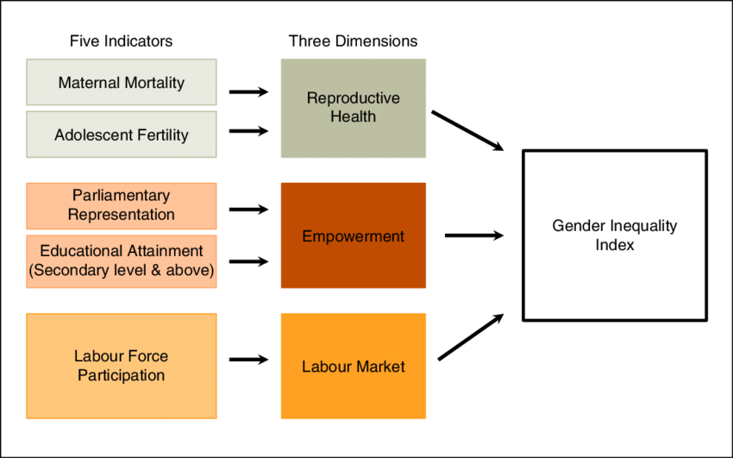
Components of gender Inequality Index (UNDP)

Slide 9
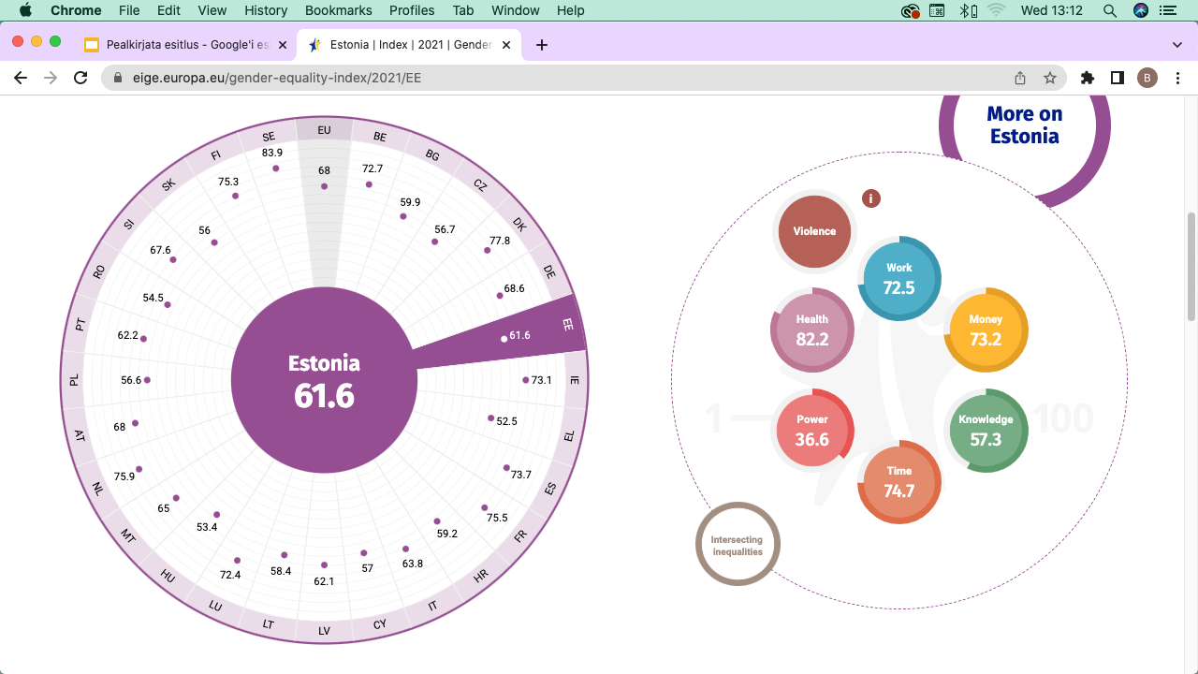
EIGE Gender Equality Index
https://eige.europa.eu/gender-equality-index/2021/DE

Slide 10
Most important environmental issues
Deforestation. growth of population
Air Pollution. While air quality has improved greatly in the last 50 years, it still remains an issue in many major cities with large populations.
Global Warming.
Water Pollution.
Natural Resource Depletion.
Water, air and soil quality
Waste management and the use of chemicals
Environmental assessment
Green public procurement, sustainable development and the urban environment
The environmental impact of industry, land use
The marine environment and the coast
Nature and biodiversity

Slide 11
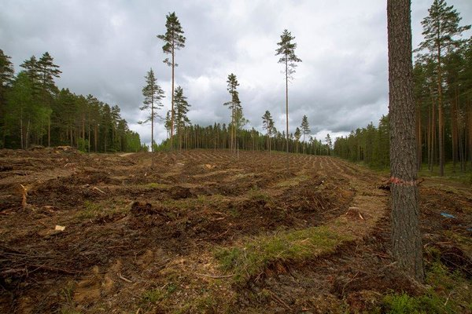

Slide 12
Gender and environmental issues
A consistent finding in psychological research is that females care more about environmental issues and engage in more conservation behaviours than males.
A large body of research (PDF) Race, class, gender and climate change communication shows a small—but consistent—gender gap in environmental views and climate change opinions. On average, women are slightly more likely than men to be concerned about the environment and have stronger pro-climate opinions and beliefs.

Slide 13
Explanations for gender gap in environmental issues perception
Scholars have proposed several explanations for this gender gap, including differences in gender socialization and resulting value systems (e.g., altruism, compassion), perceptions of general risk and vulnerability, and feminist beliefs including commitment to egalitarian values of fairness and social justice.
Some researchers also note that some of the strongest gender differences are found in concern about specific environmental problems, particularly local problems that pose health risks (USA example)
https://climatecommunication.yale.edu/publications/gender-differences-in-public-understanding-of-climate-change/

Slide 14
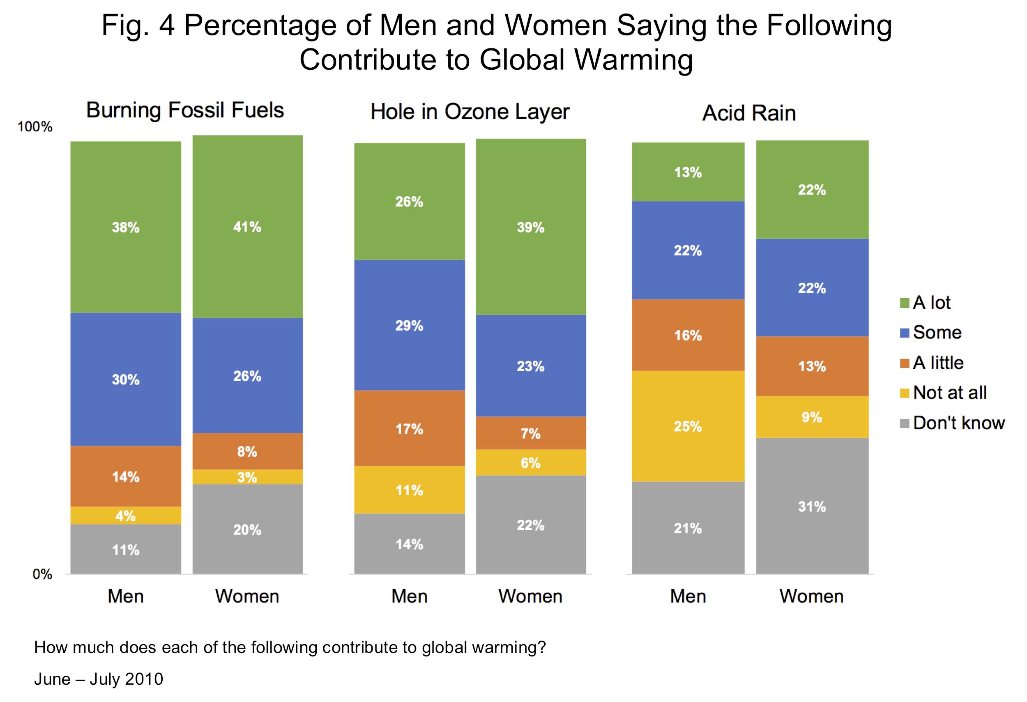

Slide 15
Higher gender equality, the less environmental issues
Evidence reveals that there is a correlation between environment and gender. When gender inequality is high, forest depletion, air pollution and other measures of environmental degradation are also high.
According to EIGE the gender perspective is relevant in all the different areas of environment policy. Gender relations play a key role in the access to and control of environmental resources, as well as the goods and services they provide.
The relevance of gender to environmental issues has been discussed since the early 1970s
Growing debate on environmental changes intersected with the emergence of studies on women’s roles in development and development policy strategies within the international women’s rights movement.
https://eige.europa.eu/gender-mainstreaming/policy-areas/environment-and-climate-change

Slide 16
Poverty, gender and climate change
The 2009 European Council Conclusions on Climate change and development underlined “the human dimension of climate change, including a gender perspective, and that poor people are most at risk, and that their resilience to climate change needs to be strengthened”.
The document also refers to gender equality and women’s empowerment.
This relates to support for programmes that contribute to a low-carbon and climate-resilient development path and adaptation to the adverse impacts of climate change: “In providing such support special attention should be paid to gender equality and women’s empowerment.”

Slide 17
Gender aspects of climate change impact
Public transport: For mobility, women depend on access to public transport to a larger degree due to lower levels of car ownership
Poverty: Due to their lower average income, women are at greater risk of energy poverty than men, and have fewer options for investing in low-carbon options such as energy efficiency and renewable energies.
Domestic heating: Women spend more time at home due to care duties, and thus depend on domestic heating to a greater extent. https://eige.europa.eu/gender-mainstreaming/policy-areas/environment-and-climate-change
Everyday practices: Implementing recycling habits into your daily life is one of the most effective ways to help lessen landfill waste, conserve natural resources, save habitats, reduce pollution, cut down on energy consumption, and slow down global warming.

Slide 18
International documents – United Nations
The United Nations play a pioneering role within the consideration of gender aspects in environmental policies. The World Summit on environment and development (Rio de Janeiro, 1992) adopted a gender perspective in all development and environment policies and programmes, leading to the promotion of women’s effective participation in the proper use of natural resources. This provided the first international precedent for including the gender perspective in promoting sustainable development.
“Women have a vital role in environmental management and development. Their full participation is therefore essential in achieving sustainable development”.

Slide 19
European documents
European report on gender and climate change (commissioned by the Danish Presidency and produced EIGE) recognise that: “Women play a vital role in sustainable development, and that gender as well as social and employment aspects need to be integrated into efforts to combat climate change in order to improve them”
European Council conclusions also state that: “Women and men affect the climate differently: their consumption patterns are different and they have different CO2 footprints, and they are not represented equally in decision-making in this field …
The European Parliament resolution of 20 April 2012 on women and climate change is explicitly concerned with exposing and addressing the links between climate change and gender.
The important role played by women in implementing mitigation measures in daily life – for example, through energy- and water-saving practices, recycling measures and the use of eco-friendly and organic products.

Slide 20
Gender equality and environment: call for actions
A balanced representation of women and men in decision-making in the field of climate change mitigation at all levels, including the EU level;
To support women in science and technology at national and European level;
To eliminate gender stereotypes and promote gender equality at all levels of education and training, as well as in working life;
To integrate the principle of gender mainstreaming into all relevant legislation, policy measures and instruments related to climate change mitigation.

Slide 21
Solutions to environmental problems
Environment is a cross-cutting issue.
Environmental change and climate change are increasingly caused by developments taking place at the global level, including those relating to demographics, patterns of production and trade, and rapid technological progress. https://eige.europa.eu/gender-mainstreaming/policy-areas/environment-and-climate-change
Gender is considered particularly relevant in climate protection policies.
UN 4th World Conference on Women in Beijing (1995) identified environment as one of 12 cri­tical areas for women. Area K of the Bei­jing Platform for Action (BPfA), on women and the environment, asserted that ‘women have an essential role to play in the development of sustainable and ecologically sound consump­tion and production patterns, and approaches to natural resource management’.

Slide 23
Practical examples of gender mainstreaming in environment and climate change
Sustainable development policies and programmes Austria, Finland, Sweden (EIGE)
As part of Finland’s presidency in the Nordic Council of Ministers in 2011, an electronic portal about climate change and gender was created.
The Nordic gender equality ministers have been working to include a gender equality perspective into solutions targeted towards mitigation and adaptation work and to disseminate information on gender equality in climate change and sustainable development.
The portal collects knowledge about climate and gender from a number of different perspectives including transport, consumption, food and energy.

Slide 24
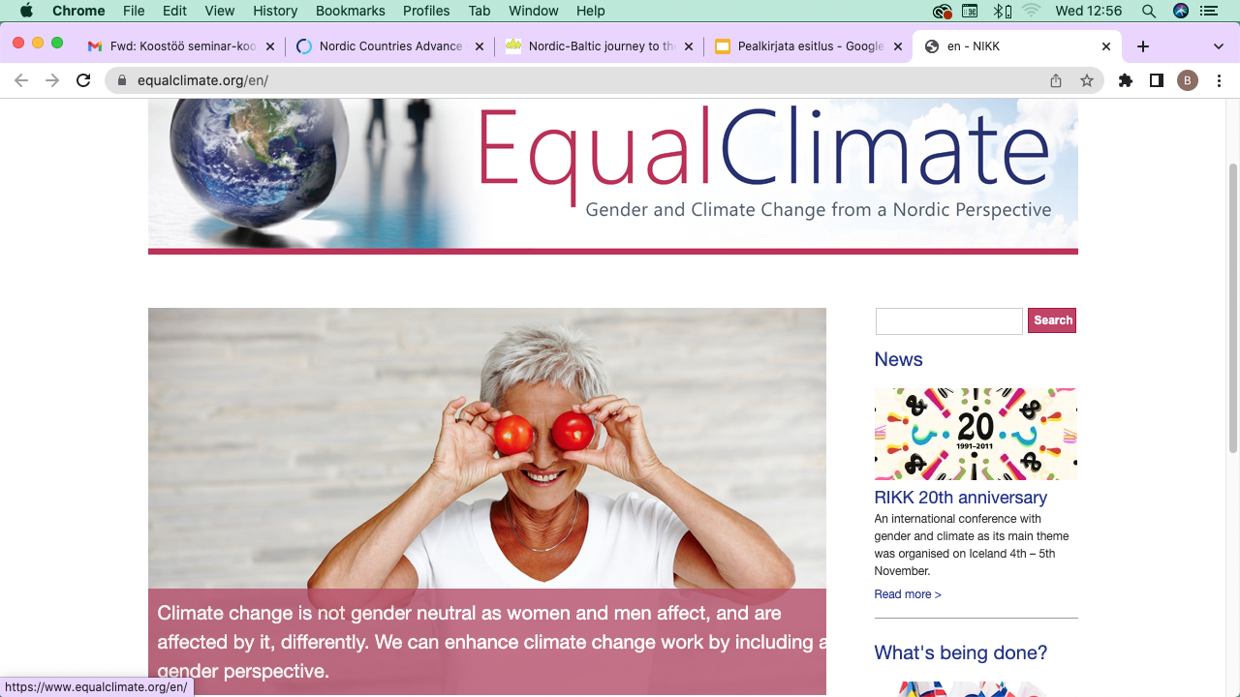

Slide 25
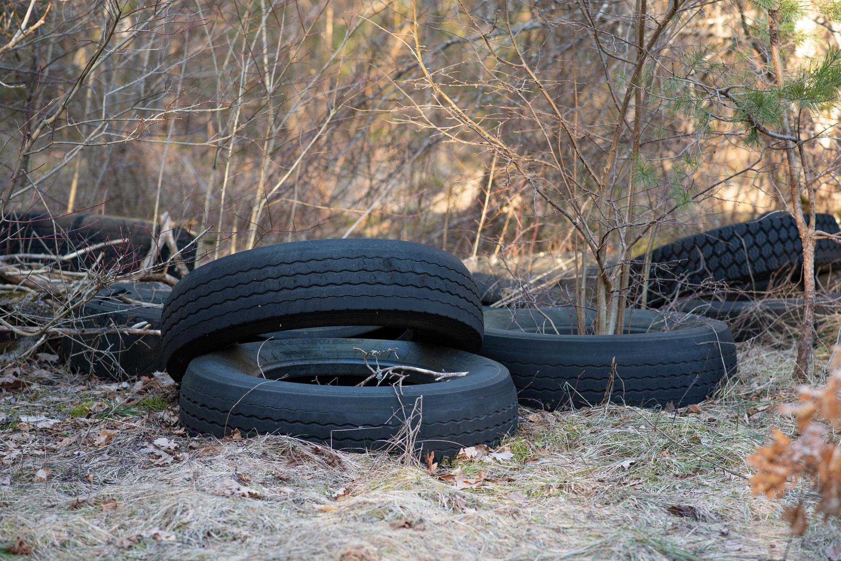
In Estonia
Naiste ja meeste võrdõiguslikkus: Keskkond ja sugu

Slide 26
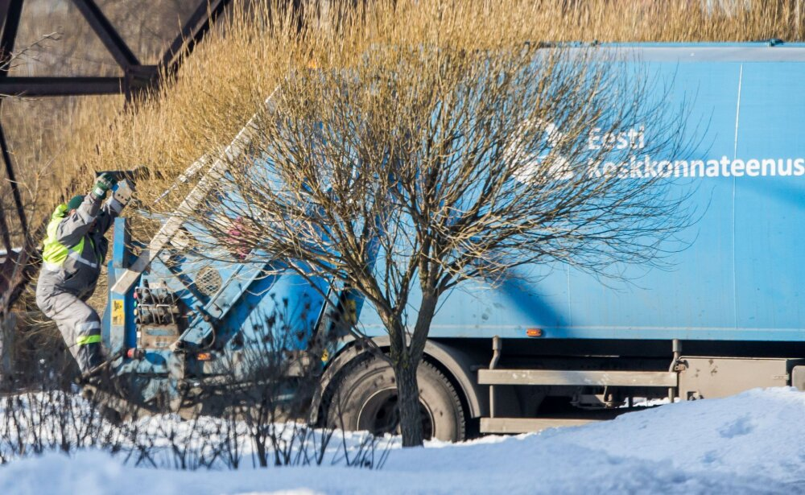

Slide 27
Thank you!

