Slide 1
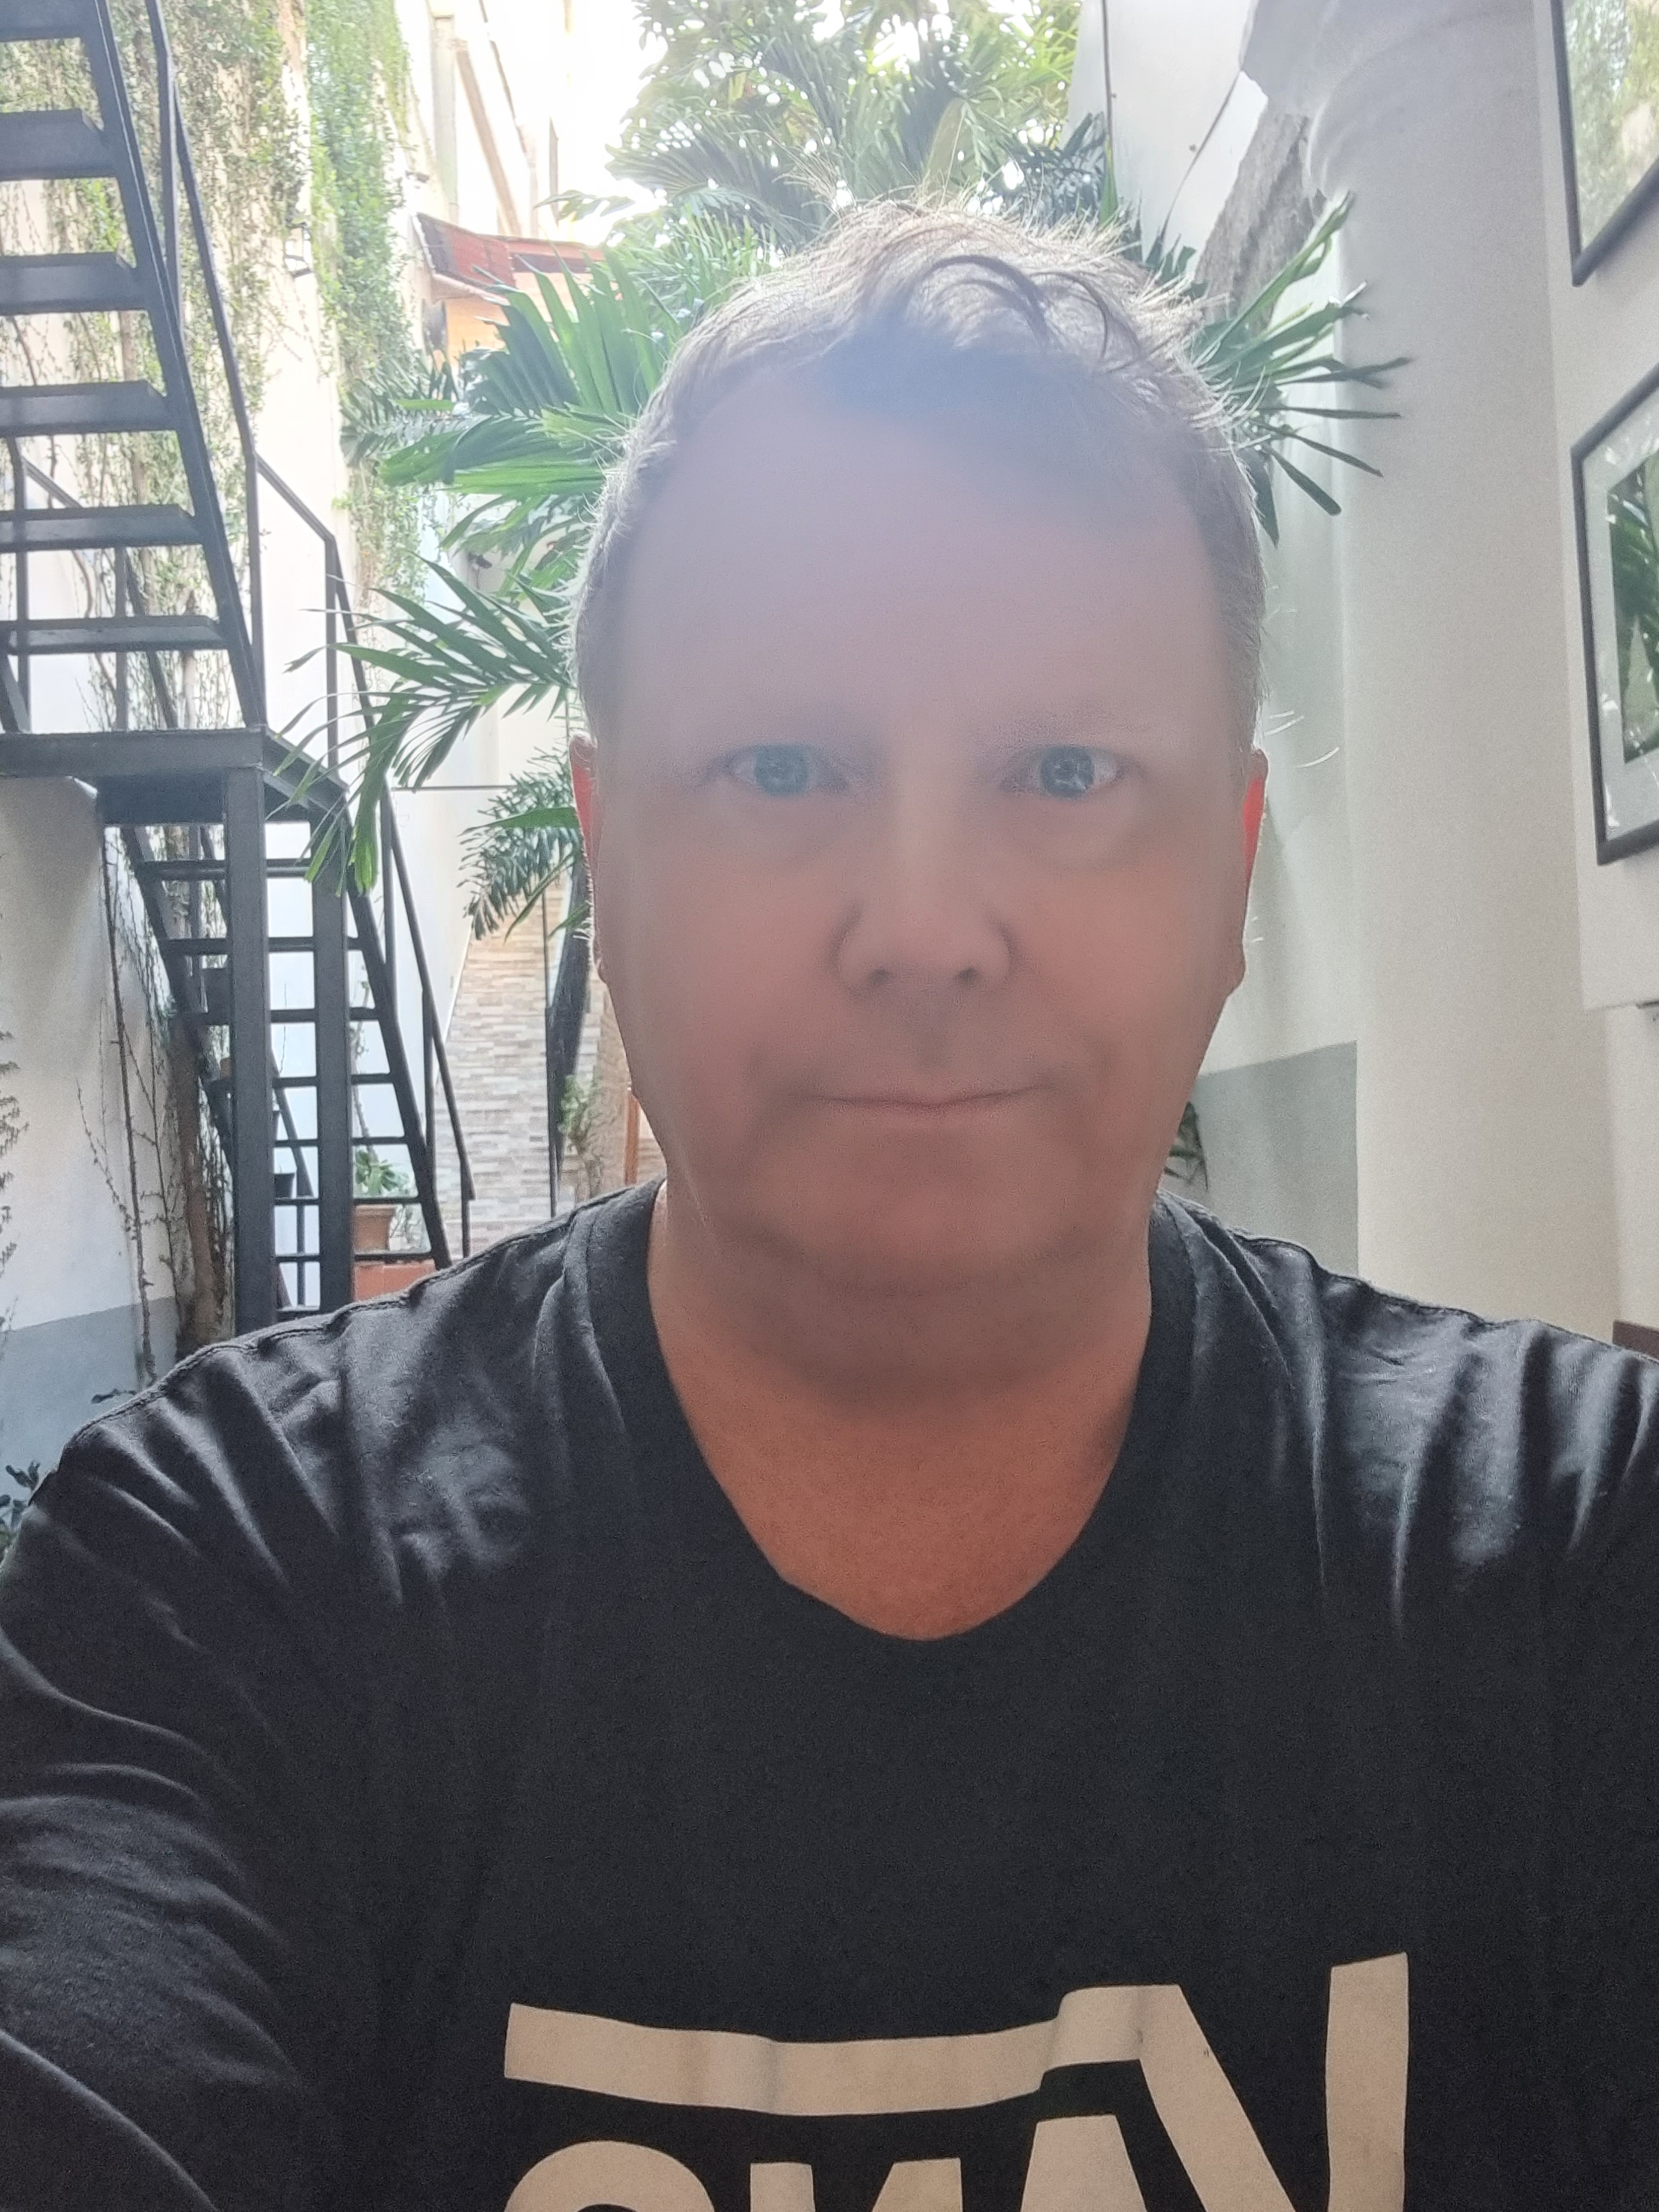



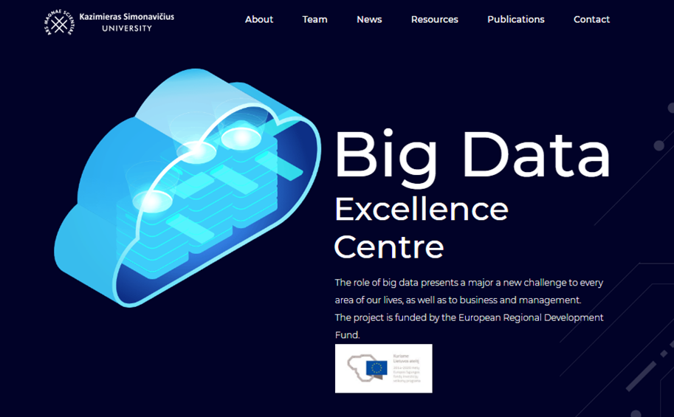

Accessible Global Education for Adult Learners and Practioners: European Perspectives
II Workshop Sessions ”Getting Closer with UN SDGs”, Vilnius, 23.4.2022
Research Director, Dr Jari Kaivo-oja Finland Futures Research Centre, Turku School of Economics, University of Turku, Adjunct Professor (University of Helsinki & University of Lapland)
Professor, Dr, Kazimiero Simonavičiaus University, KSU, Vilnius, Lithuania

Slide 2
Three Pillars of Sustainable Development
Ecological sustainability
Sustainability
Governance
Social development
Economic growth

Slide 3
Three key variables of learning: the MAS approach
Motivation
Access
Skills

Slide 4
Key trends in adult education field
Lifelong learning – continious learning challenges are big – strongly linked to intergenerational equity challenges, which is one key issue of sustainable development , links relevant to all 17 SDGs
Work life is more fragmented and linear work careers are disappearing
Work life balance problems are severe both for women and men
The VUCA phenomena: Volatility, Uncertainty, Complexity and Ambiguity
Hub and home office culture of work and work organisations (especially after COVID-19 distant work phenomena has become a big policy issue)
Complex polarisation phenemomena: Age discrimination, sex discrimination, ethical discrimination, unfair practices of work, etc.
Social inclusion mechanisms of work life are too weak and often lead to unfair social solutions
Crisis of the middle class; personal careers are not quaranteed even with higher university education
Modular educational programs: Short run training and tutoring, very focused MOOC programs
Unexpected impacts of digital transformation (Digital divide, AI, IoT, IoS, Blockchain tech, Cloud computing, sensory technologies, etc.)
Crowing importance of cognitive ergonomics (mental welfare) instead of physical ergonomics (physical welfare)
Demand of work, suppy of work and education activities need to be balanced, Basic Income Challenge

Slide 5
European Gothenburg Summit in 2017
The European Council called on Member States, the Council and the Commission to take forward a number of initiatives, including: '…strengthening strategic partnerships across the EU between higher education institutions and encouraging the emergence by 2024 of some twenty 'European Universities', consisting in bottom-up networks of universities across the EU which will enable students to obtain a degree by combining studies in several EU countries and contribute to the international competitiveness of European universities’.
The key principles of Gothenburg Summit were:
(1) Joint responsibility to put people first,
(2) We need more men and women in employment, ensuring easier access,
(3) We need fair employment and good working conditions to the labour market,
(4) We need to invest in people to facilitate transitions between jobs, and
(5) Further actions are needed (European Commission & The Government Office of Sweden 2017).

Slide 6
The European Open Science Cloud today
Today the European Open Science Cloud (EOSC) is an environment for hosting and processing research data to support EU science. The process to create the EOSC was initiated by the Commission in 2015. It aimed to develop a trusted, virtual, federated environment that cuts across borders and scientific disciplines to store, share, process and re-use research digital objects (like publications, data, and software) following FAIR principles. (F1) (Meta)data are assigned a globally unique and persistent identifier, (F2) Data are described with rich metadata (defined by R1 below), (F3) Metadata clearly and explicitly include the identifier of the data they describe, (F4) (Meta)data are registered or indexed in a searchable resource (Wilkinson et al. 2016).
The interim governance is composed of EOSC Governance Board: (1) Representatives from EU countries, countries associated with Horizon 2020 and the Commission to ensure effective supervision of the EOSC implementation, (2) EOSC Executive Board: representatives from the research and e-infrastructures communities and (3) EOSC stakeholders: a wider range of actors, consulted through a series of meetings (European Open Science Cloud 2021).
The EOSC brings together institutional, national and European stakeholders, initiatives and data infrastructures to develop an inclusive open science ecosystem in Europe. This can lead new insights and innovations, higher research productivity and improved reproducibility in science. Open science describes a more inclusive, collaborative, transparent world of research. (European Open Science Cloud 2021).

Slide 7
The European Commission´s Work programme (2021)
The EC Workprogramme includes key statements which provide updated situation analysis of European digital transformation policy. This Work Programme includes following statements (European Commission 2021, p. 4):
To ensure that this is Europe’s digital decade, the European Commission will propose a roadmap with clearly defined goals for 2030, such as for (1) connectivity, (2) skills and (3) digital public services. This approach will follow four clear principles: the right to privacy and connectivity, freedom of speech, free flow of data and cybersecurity.
The European Commission will take action across these different areas, notably with legislation covering the safety, liability, fundamental rights, and data aspects of artificial intelligence and a Data Act to set the right conditions for better control and conditions for data sharing for citizens and businesses.
In the same spirit, the European Commission will propose a new European digital identity to make it easier to do tasks and access services online across Europe and ensure people have greater control and peace of mind over what data they share and how it is used.

Slide 8
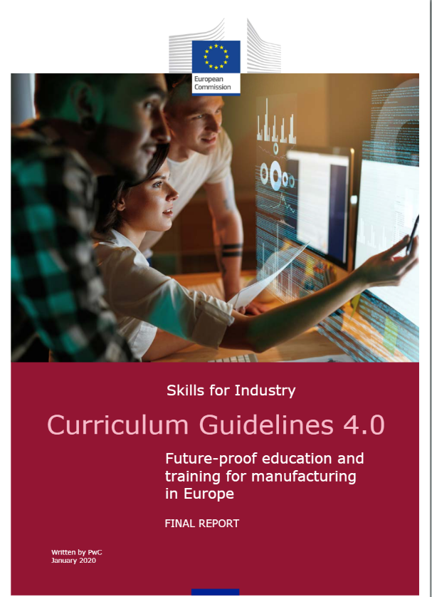
Re-assesment: Critical aspects
We present critical elements of assessment of the European Open Science Cloud. From the perspective European integration policy planning, we note that key critical elements are: (1) European Industry 4.0 Curriculum, (2) Platform Strategy of the European University System, (3) Systemic Science, Technology and Innovation Approach of the European University System, (4) Data Sovereignty Strategy of the European Union and Social Inclusion Policy of the European Union. We note also that Research Infrastructure (RI) Strategy can be seen as key element of the European University System.

Slide 9
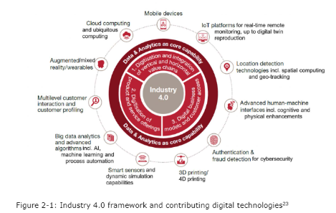
Industry 4.0 framework (European Commission 2020)

Slide 10
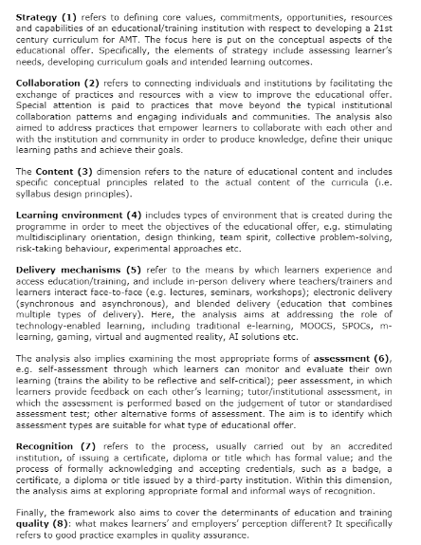
Eight pillars of Industry 4.0 curriculum work (European Commission 2020)
Strategy
Collaboration
The content
Learning environment
Delivery mechanisms
Assessment
Recognition
Education and training quality

Slide 11
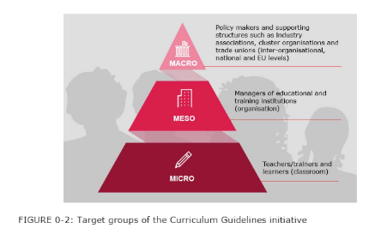
Relevant target groups for the development of adult learners: Three levels of Industry 4.0 Curriculum (European Commission 2020)

Slide 12
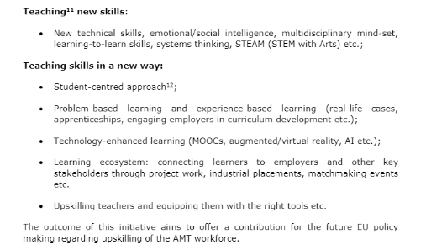
Relevant for adult learners: Teaching new skills and teaching skills in a new way (European Commission 2020)

Slide 13
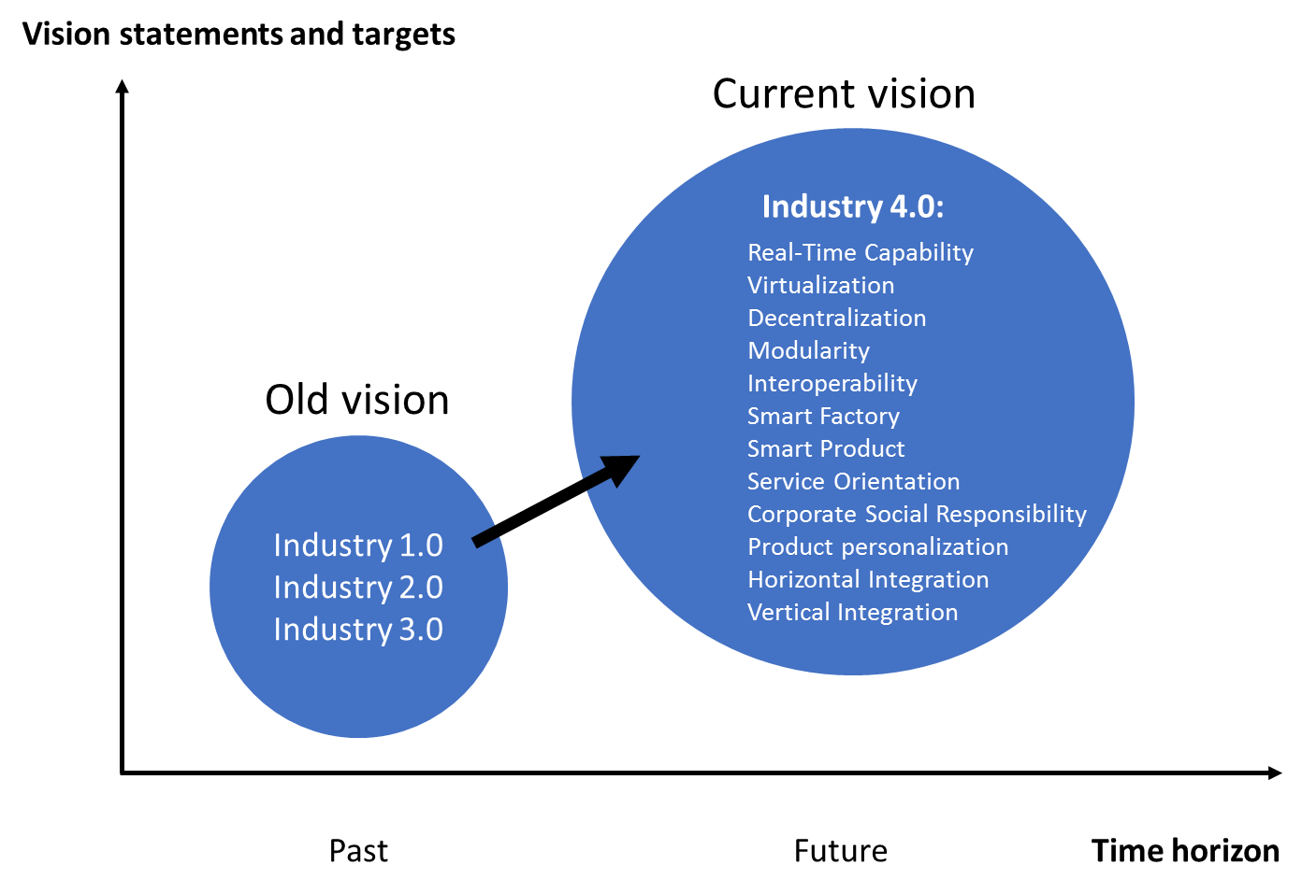
Industry 4.0 vision in a nutshell (European Commission 2020) as a part of S3

Slide 14
The evolution of strategic management and “research based” thinking (Teece 2018)
The Dynamic Capability model is only the third substantive framework for maintaining competitive advantage to emerge in the last 35 years
Dynamic Capabilities
-Markets are dynamic and competition is often disruptive
-Asset orchestration & strategy drive advantage
-Reshaping ecosystems & biz models is critical
Deep Uncertainty
RBV
VRIN (Valuable, Rare, Inimitable and Non-Substituable) assets drive value creation
barriers to competition determine longevity
all 4 VRIN
traits necessary to sustain advantage
5 Forces
industry attractiveness is the central focus
external forces
dominate
fate = static, purely competitive markets (low profit)
Risk
1980s
1990s
2000+

Slide 15
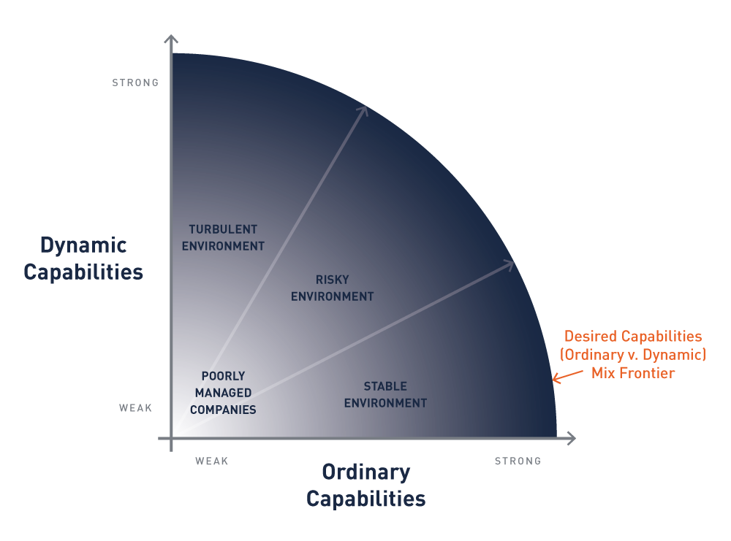
Deep uncertainty in the VUCA environment requires dynamic capabilities (modified, Teece 2016)
Higher competitiveness in the VUCA environment
Middle-range competitiveness
In the VUCA environment
Lower competitiveness in
the VUCA environment

Slide 16
Ordinary capabilities and dynamic capabilities (Kaivo-oja 2022)
High level of
dynamic capabilities
Low level of
dynmic capabilities
Partly sustainable
organisational design with
ordinary capabilities risk)
Probably a successful organisation
(sustainable organisational
design)
Probably a not
successful organisation
(not sustainable
organisational design
Partly sustainable
organisational design with
dynamic capabilities risk)
Low level of ordinary capabilities High level of ordinary capabilities

Slide 17
Accessible Global Education:Two important long-run aspects of dynamic capabilities
Durability
Tranferability
Ordinary capabilities are not underestimated
Dynamic renewal of capabilities

Slide 18
Dynamic capablities and foresight research (modified from Teece 2018)
Newer/Tools/Approaches
Influence Diagrams
Scenario Planning
Peripheral vision
Total Risk Management
Systems Thinking
Idealized Design
Leigitimation Theory
Honing Institution
Complexity Theory
Domain of Ordinary Capabilities
Accessible Global Education for Adult Learners and Practioners: European Perspectives
Certainty
Risk
Uncertainty
Ambiguity
Chaos/Ignorance
Known
Unknown
Unknowable
Traditional Tools/Approaches
Foresight and innovation activities
Cost Benefit Analysis
Net Present Value
Linear Programming
Point Forecasting
Optimization Theory
Utility Theory
Decision Trees
Bayesian Updating
Monte Carlo Simulation
Portfolio Theory
Stochastic Modeling
Insurance & hedging
The Domain of Dynamic Capabilities

Slide 19
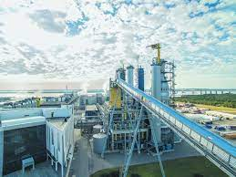







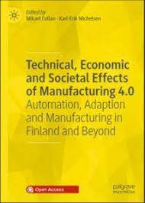


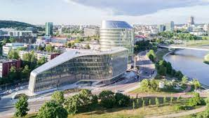
Empirical demonstration and results

Slide 20

Accessible Global Education for Adult Learners and Practioners: European Perspectives and a Finnish Case Example
A Concrete Visionary Initiative outlined
An Example of ”How Global Education for
Adult Learners and Practioners Could be
Developed”

Slide 21
Industry 6.0 Virtual University: A Finnish Initiative meeting the platform economy challenge
A significant portion of the value in the future of industry comes from ICT-based solutions. Therefore, significant research efforts should be placed on ICT in industrial domains. Currently, the top ICT research results have not been widely utilized by Finnish industry. The main reasons have been the isolation of ICT research from industry -relevant technology areas. The isolation takes place on researcher levels, but especially also on the university-company level. Hence, many companies, especially SMEs, are using off-the-shelf solutions that are far from optimal. Crucial standardization has not yet started properly. All this requires cross-pollination and activation of ICT professors to be more active towards this sector.
Isolation of resources affect also education and international impacts. By combining efforts in a well-coordinated manner, significant cost-savings can be obtained in education. This also offers a way to increase the quality of education.
We propose: Creation of the Virtual Industry 6.0 University (Figure 6). Approximately 10 new Industrial ICT professors and additional postdocs are needed to fill the gaps. These professors and existing ones need to be actively networked inside this virtual structure and towards Europe. Networking covers all aspects: education, research, internationalization, and industry collaboration.

Slide 22
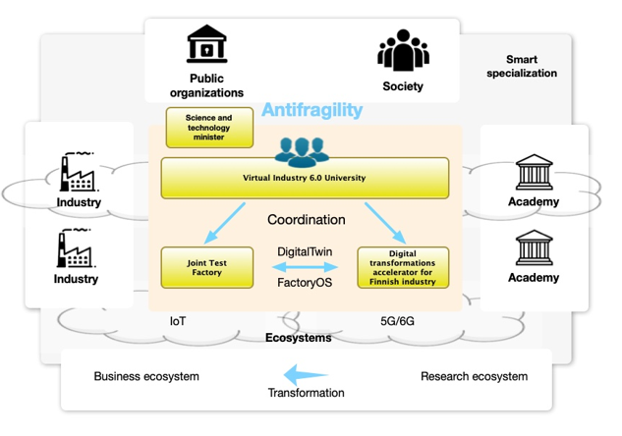
The Finnish Approach of the Industry 6.0 vision: Virtual Industry 6.0 University

Slide 23
Funding Virtual Industry 6.0 University
Ministry of Education and Culture: Professors’ and postdocs’ salaries and other costs
R&D&I programs:
  Academy of Finland: Emerging Industrial Technologies (2021-2030)
  Academy of Finland: Antifragile society (2021-2030)
  Business Finland: Industrial software (2021-2025)
  Business Finland: AI for industry (2021-2030)
  Business Finland: Ecosystem Antifragility (2021-2025)
  Business Finland: Ecosystem cross-pollination funding (2021-2030)

Slide 24
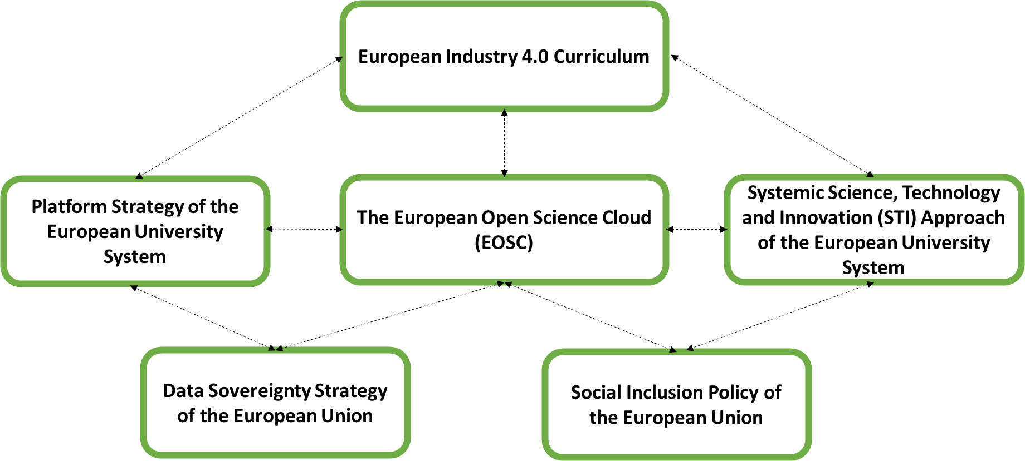
The European Open Science Cloud (EPSC) and European Initiatives – Strategic Structure

Slide 25
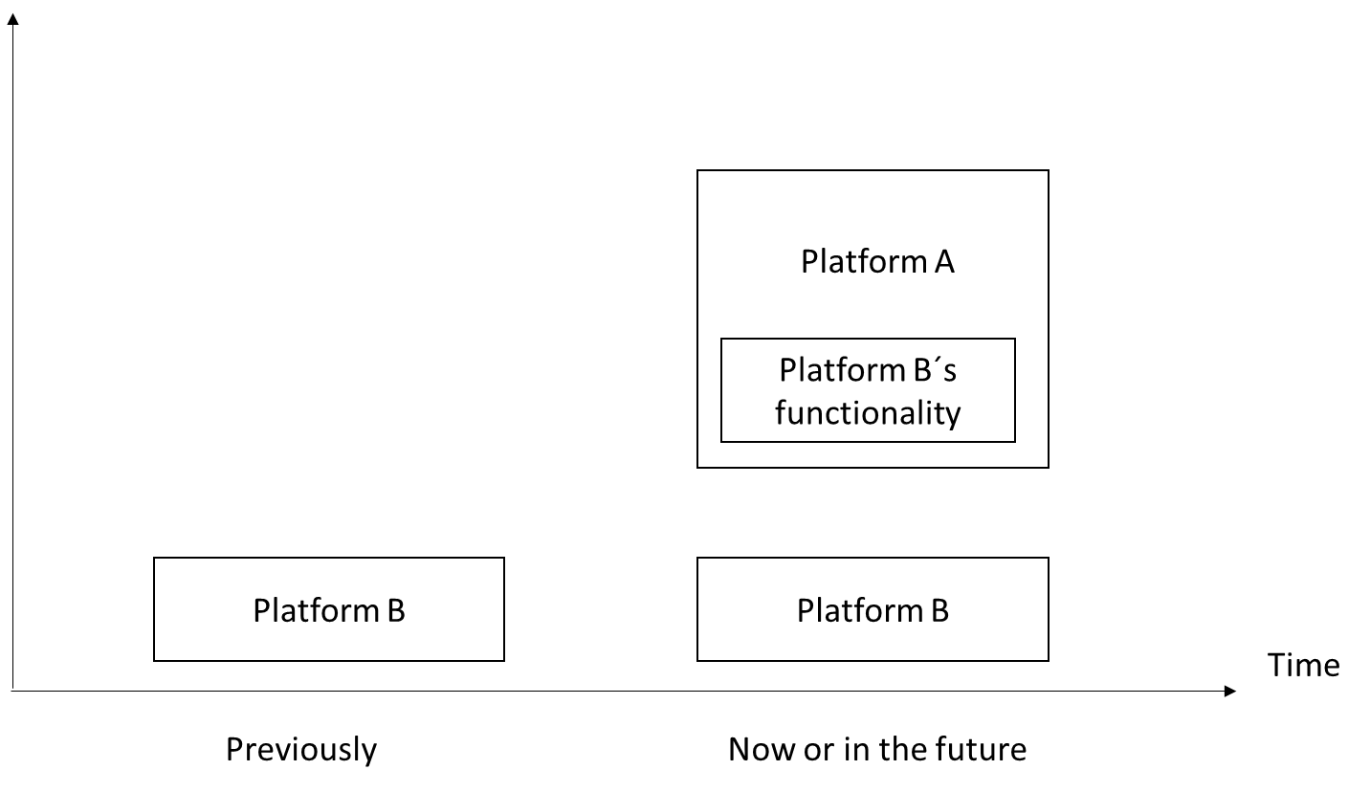
Platform economy and its evolution (Tiwana 2014, p. 36).

Slide 26
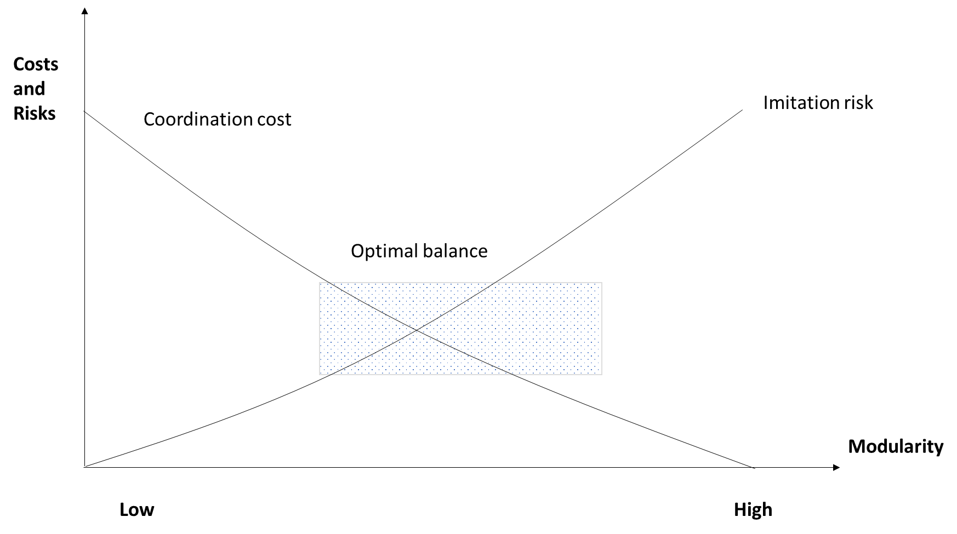
Modularisation challenge. Seeking optimal balance between coordination costs and modularity. (Tiwana 2014, p. 105)

Slide 27
Key messages of Industry 6.0 –vision in Finland
Finnish industry from the crossroads to the path of the industrial revolution Industry 6.0
Robustness is not sufficient - we need antifragile industry
The technological revolution arises from the transition from Industry X to Industry 6.0
Superior productivity needed
Customer-driven industry – mixture of globality with strong locality
Green Ocean strategies for Finland and Finnish industry
Holistic long-term development agendas
Entrepreneurship and start-ups in Industry 4.0 transformation

Slide 28
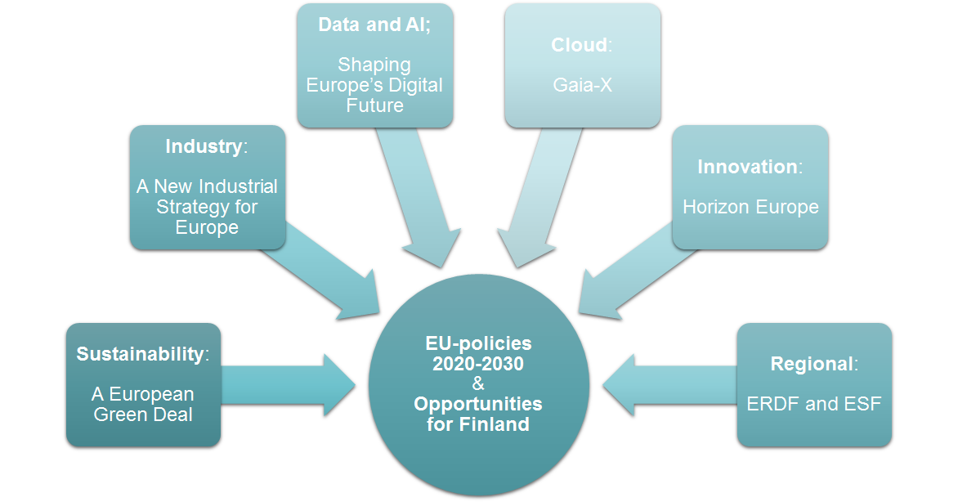
Future Actions open in the European Union
Finding 10. National funding schemes promoting larger and more strategic partnerships could be reinforced as a step forward to enhanced positioning in European initiatives and platforms. The selection criteria of ESIF funded projects could require the explanation of the relevance for the EU level, contacts and collaborations with potential EU initiatives and partners in the field. The Seal of Excellence could be used as a downstream initiative, but upstream initiatives would have additional gains considering the low participation in EU programmes possibly due to the lack of experience and of international networks. This could also counterbalance the discouraging effect that easier national funding accessibility has over the participation in national programmes.
Finding 11. Working hand in hand on capacity building and talent generation and attraction to research infrastructures. Current ERDF funding devoted to generating research infrastructures can have a tremendous impact in boosting R&I capacities in Lithuania if it is well combined with measures for the use of these infrastructures in joint research business projects. Research infrastructures funding could assess the attraction and retention of talent an integral part of their long-term sustainability plans.
Future Actions

Slide 29
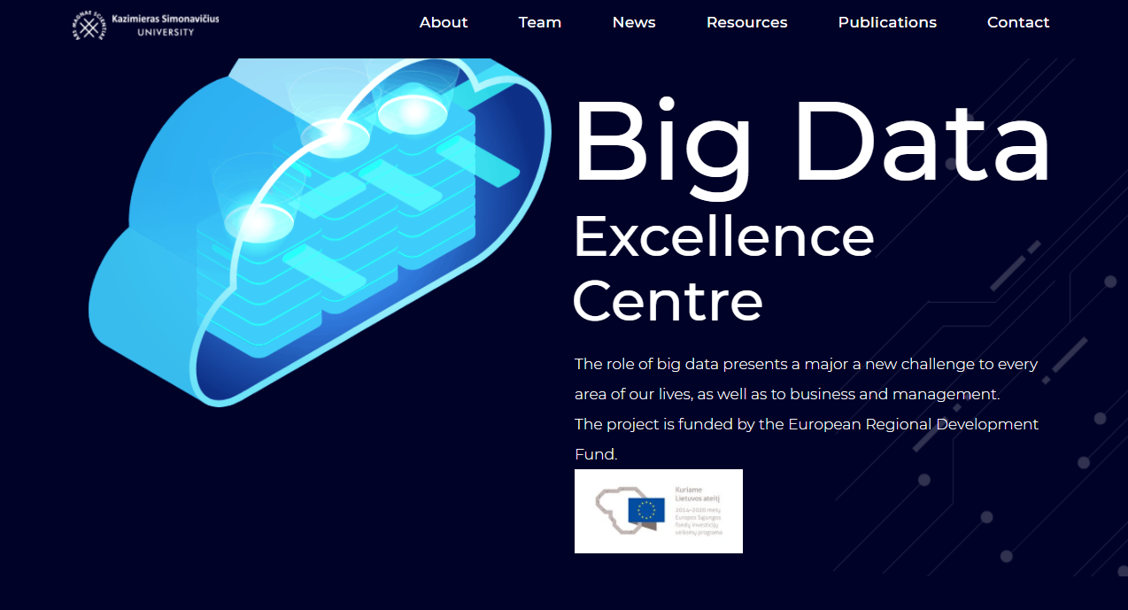
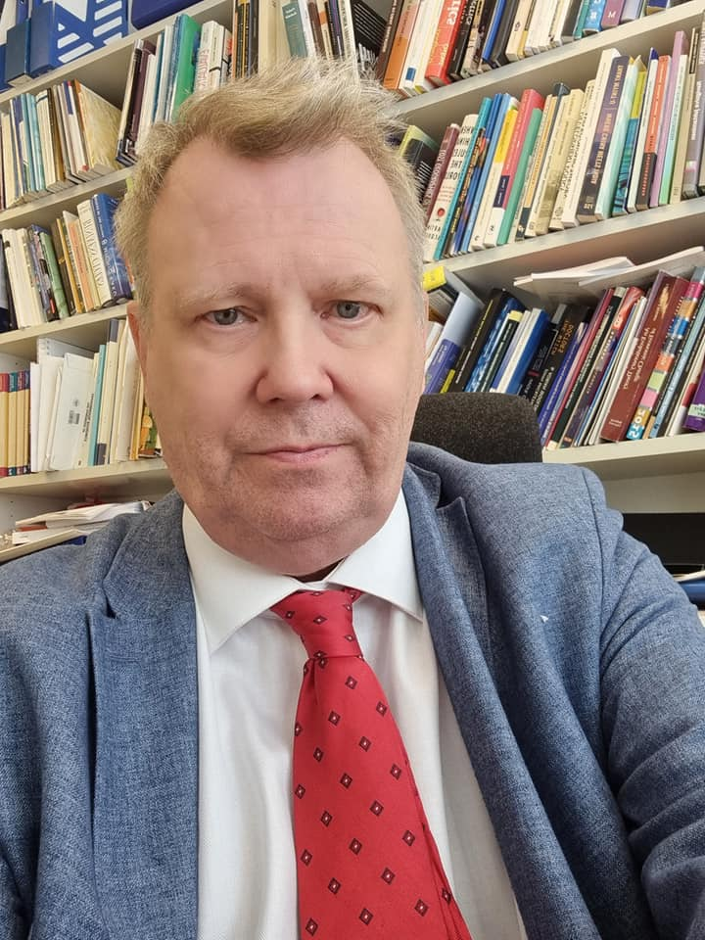



Thank you for your attention!
Research Director, Adjunct Prof. Dr Jari Kaivo-oja, Finland Futures Research Centre, Turku School of Economics, University of Turku, Professor, Dr Jari Kaivo-oja, Big Data Excellence Center, Kazimieras Simonavicius University

